Slide 1
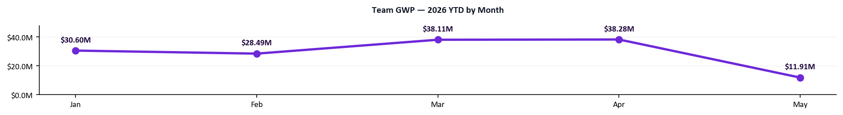
Q2 Team Scoreboard
Generated May 12, 2026
As of May 12, 2026 | 42 days into Q2 | 49 days remaining
$31.8M
77%
23,808
9
Team GWP Q2 YTD | Proj. $68.8M
Activity Compliance Q2
Submissions Q2 YTD
Net New Agencies Appointed
Pacing 113% of Q1 Final
AT RISK
Pacing 112% of Q1 Final
38% of Goal | 9 / 24 target
▼ $5.1M vs Apr pace
▲ 29pp vs Q1 avg (48%)
▲ 5951 vs Apr (17857)
▲ 4 vs Q1 final (5)
Q2 MIX
$20.5M
$6.1M
$5.2M
New Business (65%)
Renewals (19%)
Endorsements (16%)
$60.7M
48%
45,952
5
Q1 FINAL
GWP
Activity
Submissions
Agencies Appointed
MTD (May): $7.45M written · $19.25M pace · 12/31 days elapsed
Notes:
PURPOSE
Gives every rep a single-page snapshot of where the team stands in Q2 before diving into individual performance.
HOW THE NUMBERS ARE CALCULATED
- Team Q2 GWP: sum of all bound premium written by BDMs + BDAs since Apr 1.
- Q2 Projected Finish: (Q2 GWP to date ÷ days elapsed) × 91 days in the quarter, shown as "Proj." in the GWP tile label.
- Q2 Submissions: total submission count from agencies assigned to Growth Team reps since Apr 1.
- Activity Compliance Q2: each rep's weekly calls + meetings averaged across Q2 weeks vs. weekly goal (40 BDMs / 50 BDAs). This tile shows the team average.
- Net New Agencies Appointed: count of "Activated Won" deals in the HubSpot NNA pipeline since Apr 1, BDMs only, filtered to deal names starting with "Appointed - " (true new appointments — excludes "Already appointed", "No deal received", "Duplicate", and pending paperwork tags). Goal = 4 per BDM per quarter. Green = at goal, amber = halfway, red = behind.
- Badge pills: GWP and Submissions badges show pacing vs. Q1 Final total. Activity badge shows On Track / At Risk / Behind.
- "vs last month" comparison: each box shows a delta vs the prior month (or Q1 avg for activity/agencies). Green ▲ = improving, red ▼ = declining.
- Q2 MIX strip (purple): breaks the Q2 GWP figure into New Business / Renewals / Endorsements with each segment's $ amount and % of total. Shows what the team controls (gross production before cancellations).
- Q1 Final strip (gray): Q1 full-quarter actuals for each metric — GWP, Activity %, Submissions, Agencies Appointed. Use as the benchmark for the four KPI tiles above.
- MTD Pace: (GWP written this month to date ÷ days elapsed this month) × total days in the month.
- YTD chart: total company GWP per month (new business + renewals + endorsements) for each month of 2026.
WHAT TO LOOK FOR
- Read top to bottom: tiles answer "where are we vs goal?", Q2 MIX answers "what's driving GWP?", Q1 Final answers "how does this compare to last quarter?", MTD bar answers "are we on pace this month?", trend chart shows the trajectory.
- If Q2 MIX shows endorsements running unusually high relative to NB, the headline GWP is leaning on existing-book activity, not new wins.

Slide 2
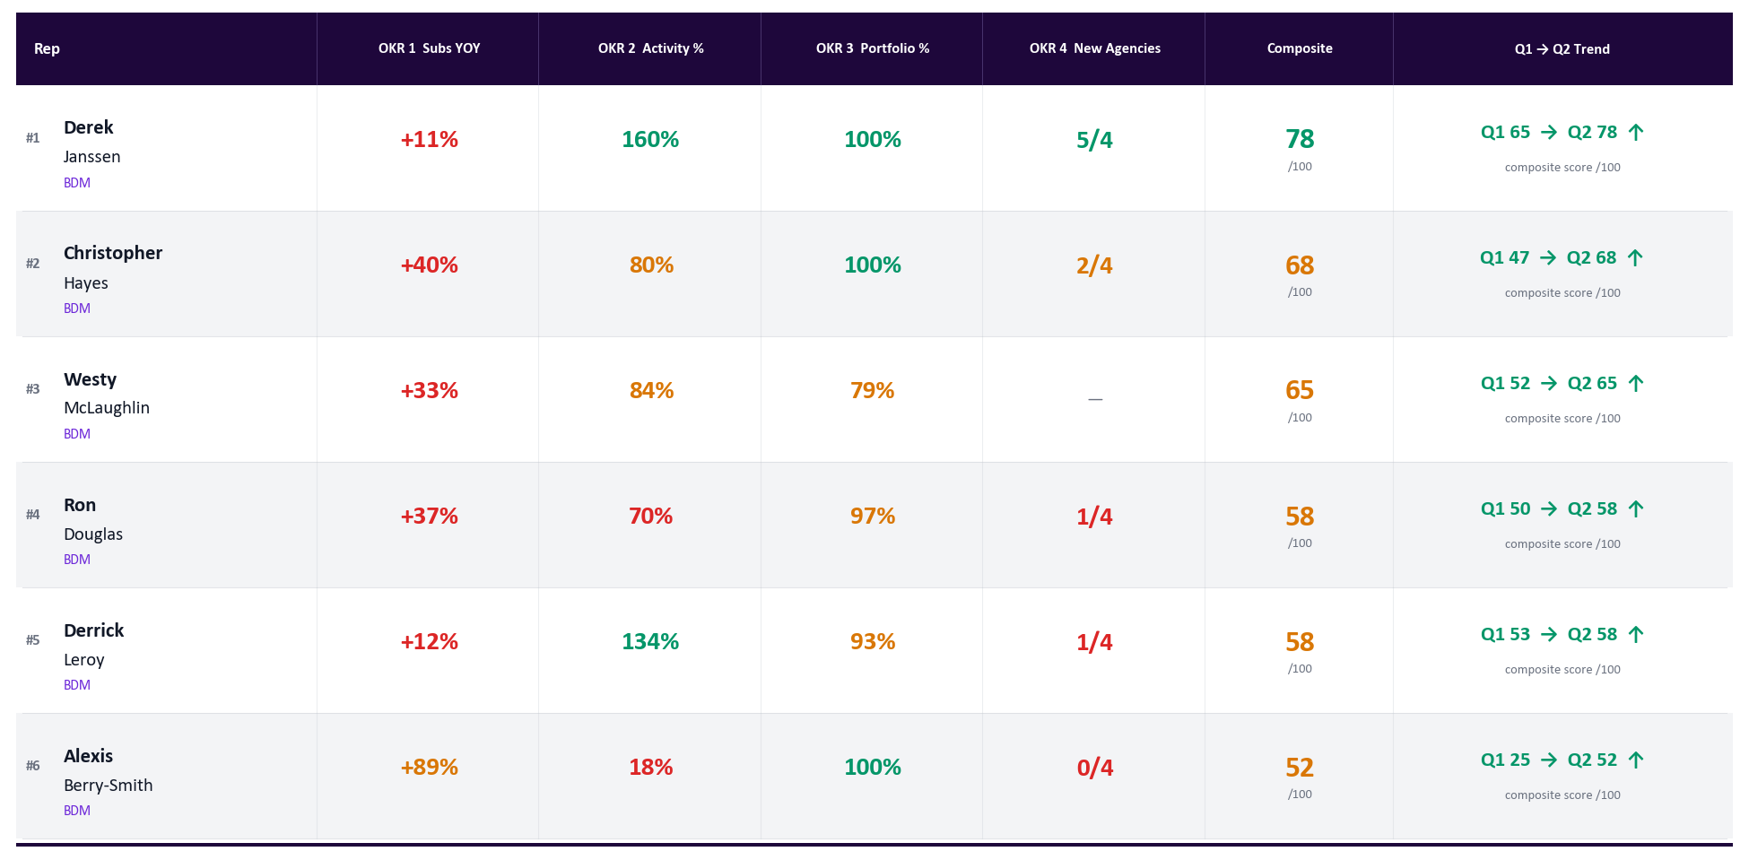
BDM Performance Rankings — Q2 2026
Generated May 12, 2026
Q2 2026 YTD (Apr 1–May 12) | Green = on target | Amber = at risk | Red = behind | Goal: ≥40 acts/wk | Ranked by composite OKR score
Notes:
PURPOSE
Shows where every BDM ranks in Q2. The goal is transparency — everyone sees the same numbers so there are no surprises.
HOW THE NUMBERS ARE CALCULATED
- Q2 GWP: total bound premium written by the rep since Apr 1.
- Q2 Subs: total submission count (quotes + applications) for the rep since Apr 1.
- OKR 1 — Subs YOY %: (Q2 subs to date this year ÷ same date range last year) − 1. Green = +100% or more vs. last year.
- OKR 2 — Activity %: (avg weekly calls + meetings) ÷ 40 goal. Green = 100%+. Amber = 75–99%. Red = below 75%.
- OKR 3 — Portfolio Active %: active agencies ÷ total assigned agencies. Active = any 2026 submission on the agency from any source (BDM, BDA, or direct). Green = 75%+.
- OKR 4 — New Agencies: count of "Activated Won" deals in the HubSpot NNA pipeline since Apr 1, filtered to deal names starting with "Appointed - " (excludes "Already appointed", "No deal received", "Duplicate", and pending paperwork). Goal = 4 per quarter.
- Composite Score /100: weighted blend of all 4 OKRs. Higher = stronger overall Q2 performance.
- Trend arrow and Q1→Q2 score: composite score from Q1 final vs. Q2 current — shows whether a rep is improving or declining.

Slide 3
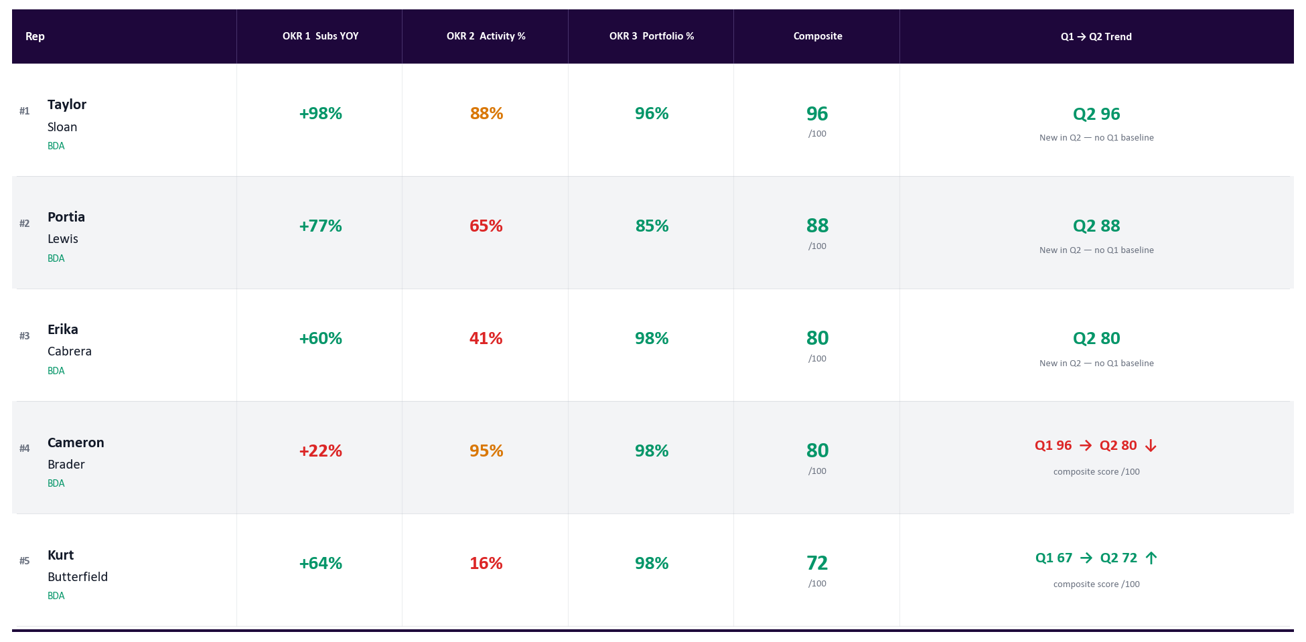
BDA Performance Rankings — Q2 2026
Generated May 12, 2026
Q2 2026 YTD (Apr 1–May 12) | Green = on target | Amber = at risk | Red = behind | Goal: ≥50 acts/wk | Ranked by composite OKR score
Notes:
PURPOSE
Same ranking view as BDMs but for BDAs. BDAs have a higher activity goal and do not have an OKR 4 (new agency activation).
HOW THE NUMBERS ARE CALCULATED
- Q2 GWP and Subs: same as BDMs — bound premium and submission count since Apr 1.
- OKR 1 — Subs YOY %: (Q2 subs to date ÷ same period last year) − 1. BDA Q2 accountability started Apr 20 for Cabrera, Lewis, and Sloan — their YOY is calculated from that date forward.
- OKR 2 — Activity %: (avg weekly calls + meetings) ÷ 50 goal. BDA goal is 50 acts/week, not 40.
- OKR 3 — Portfolio Active %: same formula as BDMs. Active = any 2026 submission on the agency from any source. Green = 75%+ of assigned agencies active. BDA target = 70%.
- Composite Score /100: weighted blend of OKRs 1–3 (no OKR 4 for BDAs).
- Trend: Q1 composite score vs. Q2 current composite — arrow shows direction of change.

Slide 4
Activity Dashboard — Q2 2026 | BDMs | Calls + Meetings
Generated May 12, 2026
Q2 YTD | Apr 1–May 12 | BDMs Only | Goal: 40 acts/wk | Emails excluded
Rep
Apr 6-12
Apr 13-19
Apr 20-26
Apr 27-May 3
May 4-10
May 11-12
Avg %
Derek Janssen
89
58
67
63
43
6
160%
Ron Douglas
17
43
34
47
0
2
70%
Christopher Hayes
39
42
25
40
15
8
80%
Derrick Leroy
50
48
65
51
54
12
134%
Westy McLaughlin
46
29
28
39
25
7
84%
Alexis Berry-Smith
0
0
4
0
32
22
18%
Rep
Role
Calls
Meetings
Inbound
Total
Avg/Wk
% to Goal
Derek Janssen
BDM
334
47
60
381
64.0
160%
Ron Douglas
BDM
124
22
68
146
28.2
70%
Christopher Hayes
BDM
171
11
30
182
32.2
80%
Derrick Leroy
BDM
318
11
36
329
53.6
134%
Westy McLaughlin
BDM
175
11
39
186
33.4
84%
Alexis Berry-Smith
BDM
52
6
2
58
7.2
18%
Notes:
PURPOSE
Shows week-by-week activity for every BDM. Activity is the leading indicator — GWP follows from consistent outreach.
HOW THE NUMBERS ARE CALCULATED
- Each cell = total calls + meetings logged in HubSpot for that rep in that calendar week. Emails are excluded.
- Goal = 40 acts/week per BDM.
- Green = 40+ (100% of goal). Amber = 30–39 (75–99%). Red = below 30 (<75%). Gray = zero logged that week.
- Avg % (right column): average of each week's (acts ÷ 40) across all Q2 weeks to date. This is the same number shown in OKR 2 on the rankings slide.
- Summary table below the heatmap: Calls and Meetings are Q2 totals. Avg/Wk = total acts ÷ weeks elapsed. % to Goal = Avg/Wk ÷ 40.
- BDA Activity Dashboard is on the next slide.

Slide 5
Activity Dashboard — Q2 2026 | BDAs | Calls + Meetings
Generated May 12, 2026
Q2 YTD | Apr 1–May 12 | BDAs Only | Goal: 50 acts/wk | Emails excluded
Rep
Apr 6-12
Apr 13-19
Apr 20-26
Apr 27-May 3
May 4-10
May 11-12
Avg %
Cameron Brader
31
58
38
57
53
6
95%
Erika Cabrera
21
39
14
8
41%
Portia Lewis
33
34
53
10
65%
Taylor Sloan
48
58
54
15
88%
Kurt Butterfield
0
0
1
0
39
13
16%
Rep
Role
Calls
Meetings
Inbound
Total
Avg/Wk
% to Goal
Cameron Brader
BDA
266
9
30
275
47.4
95%
Erika Cabrera
BDA
76
6
4
82
20.5
41%
Portia Lewis
BDA
124
6
13
130
32.5
65%
Taylor Sloan
BDA
167
8
12
175
43.8
88%
Kurt Butterfield
BDA
51
2
2
53
8.0
16%
Notes:
PURPOSE
Same heatmap layout as BDMs but for BDAs. BDAs have a higher weekly goal because outbound activity is the core of their role.
HOW THE NUMBERS ARE CALCULATED
- Each cell = calls + meetings for that BDA in that week. Emails excluded.
- Goal = 50 acts/week per BDA.
- Green = 50+ (100%). Amber = 37–49 (75–99%). Red = below 37 (<75%). Gray = zero logged.
- Erika Cabrera, Portia Lewis, and Taylor Sloan: gray cells before the week of Apr 20 are expected — their Q2 activity accountability started that week, so earlier weeks are grayed out rather than shown as red.
- Avg % (right column): average of each week's (acts ÷ 50) across the weeks they are accountable for. Matches OKR 2 on the rankings slide.
- Summary table: totals are counted from Apr 1 for all BDAs, except Cabrera/Lewis/Sloan whose calls and meetings are counted from Apr 20.
- BDM Activity Dashboard is on the previous slide.

Slide 6
Account Health & Agency Engagement
Generated May 12, 2026
Active vs Dormant Agencies | BDMs + BDAs | Active = any 2026 submission on the agency | Engagement Rate vs portfolio
Rep
Portfolio
Active
Dormant
Eng. %
Q1 GWP
Q2 Subs
Q2 Binds
Q2 GWP
Q2 Renew
Q2 Cancel
Derek Janssen
53
53
0
100%
$23.4M
5472
415
$10.3M
$3.3M
$3.2M
Christopher Hayes
45
45
0
100%
$11.7M
2636
272
$5.4M
$830K
$2.2M
Ron Douglas
35
34
1
97%
$9.7M
4213
238
$5.7M
$982K
$2.8M
Derrick Leroy
30
28
2
93%
$7.7M
2470
197
$3.2M
$483K
$1.2M
Alexis Berry-Smith
22
22
0
100%
$1.4M
1400
110
$2.6M
$118K
$1.2M
Westy McLaughlin
14
11
3
79%
$275K
147
6
$67K
$15K
$44K
BDAs — Business Development Associates (goal: ≥70% portfolio active)
Kurt Butterfield
42
41
1
98%
$2.9M
3054
77
$2.0M
$74K
$561K
Cameron Brader
48
47
1
98%
$2.5M
712
36
$970K
$187K
$30K
Taylor Sloan
26
25
1
96%
$728K
436
15
$280K
$61K
$243K
Portia Lewis
53
45
8
85%
$406K
1190
27
$757K
$24K
$158K
Erika Cabrera
42
41
1
98%
$72K
2078
41
$513K
$0
$188K
Unassigned Agencies — submitted in Q2 but not yet assigned to a rep
Unassigned
500
500
—
—
$0
21055
712
$612K
—
—
BDMs
BDAs
TEAM
199 portfolio · 193 active · 6 dormant
211 portfolio · 199 active · 12 dormant
410 portfolio · 392 active · 96% engaged
Notes:
PURPOSE
Shows how actively each rep is working their assigned book. An agency assigned but not submitting in 2026 is a missed opportunity. Engagement % (OKR 3) is the headline number per rep.
HOW THE NUMBERS ARE CALCULATED
- Portfolio: agencies assigned to the rep in HubSpot. BDMs are matched via the owner_2 property; BDAs via onboarding_success_agent.
- Active: any agency in the rep's portfolio that has at least one 2026 submission from any source — including subs that came through a BDA below the BDM. Uses a normalized name match (strips LLC/Inc/Corp/DBA, punctuation, case).
- Dormant: Portfolio − Active. Agencies assigned to the rep with zero 2026 submissions. Specific names are listed on the next slide (Dormant Agencies — Detail by Rep).
- Eng. % (Engagement): Active ÷ Portfolio × 100. This is OKR 3. Green = 75%+. Amber = 50–74%. Red = below 50%. BDM target = 100%. BDA target = 70%.
- Q1 GWP: gross written premium from this rep's book in Q1 2026 (reference column).
- Q2 Subs / Q2 Binds / Q2 GWP: submission, bind, and premium counts for Q2 2026 to date (Apr 1 → today). Only includes agencies assigned to this rep.
- Q2 Renew / Q2 Cancel: GWP from Q2 renewals and cancellations. If cancels approach renewals, that rep has a retention problem.
- Unassigned row: agencies that submitted in Q2 but did not map to any rep's HubSpot book by name. Not part of the team portfolio total.

Slide 7
Dormant Agencies | Detail by Rep
Generated May 12, 2026
Agencies in each rep's HubSpot portfolio with zero 2026 submissions | Refreshed 2026-05-12
BDMs (3 reps with dormant agencies)
BDAs (5 reps with dormant agencies)
Ron Douglas
1 dormant
Cameron Brader
1 dormant
1 of 35 agencies dormant
1 of 48 agencies dormant
•
Southwest Insurance, LLC
•
Trinity Ins Services Llc
Derrick Leroy
2 dormant
Erika Cabrera
1 dormant
2 of 30 agencies dormant
1 of 42 agencies dormant
•
Awesome Group Llc Dba Phoenix Services Ltd
•
J.c.a. Consultant, Inc.
•
Eagles Insurnace Agency Llc
Portia Lewis
8 dormant
Westy McLaughlin
3 dormant
8 of 53 agencies dormant
3 of 14 agencies dormant
•
Allcom Insurance Corporation
•
Block Insurance
•
Allstars Insurance Partners, Inc
•
RRL Insurance
•
Assured Insurance Consultants, LLC
•
Robertson Ryan
•
Clark Farley Insurance Agency - A Relation Company
•
Lake Marion Agency LLC
•
Paramount Trucking Specialist Llc
•
Patrick Phillips Insurance Agency,
•
TransRisk LLC
Taylor Sloan
1 dormant
1 of 26 agencies dormant
•
Titanic Insurance Services Inc.
+ 3 reps with 100% active portfolios are not shown (zero dormant agencies).
Notes:
PURPOSE
Pairs with the Account Health slide. That slide gave you the dormant count; this slide names the specific agencies so reps can act — call them, get a sub in, or escalate. Driving these counts down is the path to OKR 3 (100% portfolio engagement for BDMs, 70% for BDAs).
HOW THE LIST IS BUILT
- Portfolio per rep is pulled from HubSpot live: BDMs via owner_2, BDAs via onboarding_success_agent.
- An agency is DORMANT if it has zero 2026 submissions from any source (loose lens — same definition used on the Account Health slide). Name matching is normalized (strips LLC/Inc/Corp/DBA, punctuation, case) so 'Acme, LLC' and 'Acme LLC' match the same agency.
- Card color stripe codes severity: red (5+ dormant), orange (3–4), amber (1–2), green (0).
- Reps with zero dormant agencies aren't shown as empty cards — they're tallied in the footer line.

Slide 8
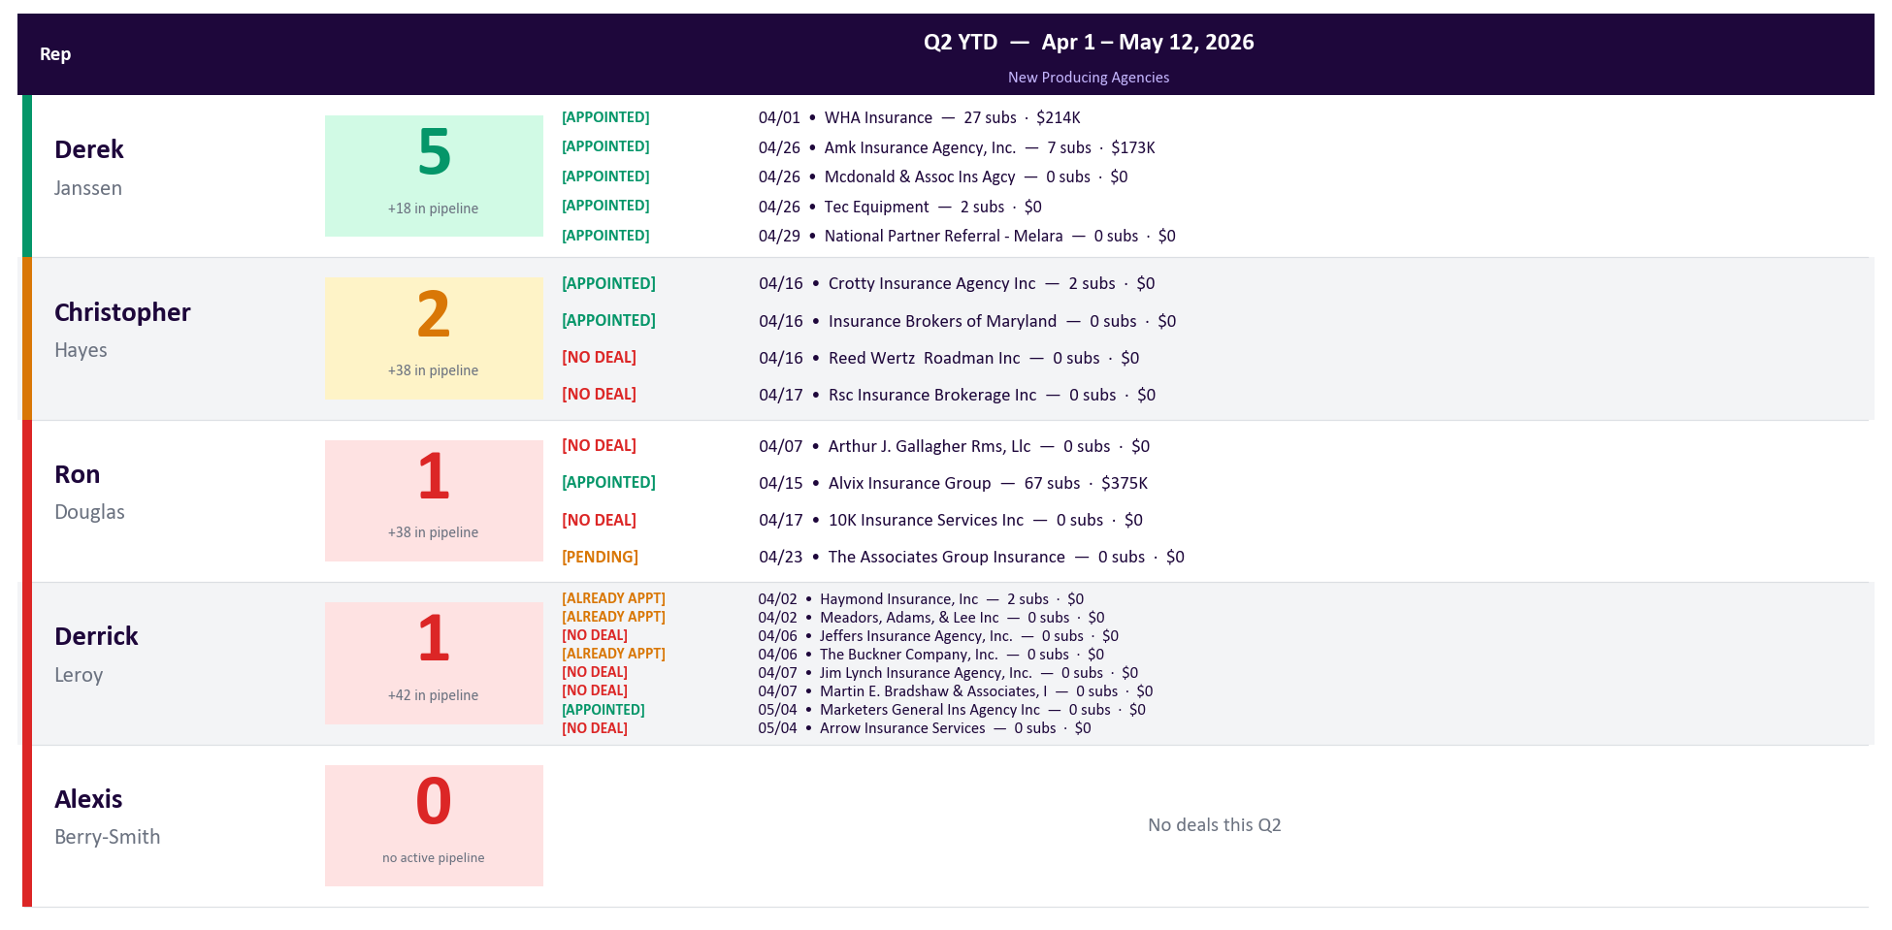
New Producing Agencies | Q2 YTD
Generated May 12, 2026
BDMs Only | All Activated-Won NNA deals shown w/ status tag + close date · OKR4 count = APPOINTED only · Goal: 4 per BDM/quarter
Notes:
PURPOSE
OKR 4 — tracks BDM appointment performance and whether each newly-appointed agency is actually producing. Two signals: did we sign them this quarter, and have they started submitting?
HOW THE NUMBERS ARE CALCULATED
- Source: HubSpot deals in the Net New Agency (NNA) pipeline, stage = 'Activated Won', closedate >= 2026-04-01.
- Filter: only deals whose name starts with 'Appointed - ' count toward the OKR. BDMs use deal name prefixes to tag outcomes — we only credit true new appointments.
• 'Appointed - <Agency>' → counts ✓
• 'Already appointed - <Agency>' → excluded (relationship pre-existed)
• 'No deal received - <Agency>' → excluded (paperwork never came back)
• 'Duplicate - <Agency>' → excluded
• 'Deal created / pending paperwork - <Agency>' → excluded (not closed yet)
- Goal = 4 true new appointments per BDM per quarter (20 team total). Green = 4+. Amber = 2–3. Red = 0–1.
- Each agency name on the slide has its 'Appointed -' prefix stripped and is suffixed with: (a) its Q2 submission count and (b) the bound GWP it has generated in Q2 (e.g., 'Acme Insurance — 3 Q2 subs · $145K GWP'). Zero Q2 subs = appointed but not producing yet (reactivation outreach). $0 GWP with subs > 0 = quoting but not binding (pricing or quality issue).
- '+X in pipeline' under the count = NNA deals still in earlier stages (Identified, Outreach, Discovery, Decision Maker Bought-In, Education, Intent to Partner, Onboarding/Setup). Near-term appointment pipeline.
- Q1 reference is in the appendix.
- We are 42 days into a 91-day quarter.

Slide 9
Team Wins — Top 20 Agencies Q2 2026
Generated May 12, 2026
Ranked by Q2 GWP (left) and Q2 Submissions (right) · Mint-shaded row = new vs last week’s deck · Apr 1–May 12
Top 20 Agencies — Q2 GWP Written
Top 20 Agencies — Q2 Submissions
#
Rep
Agency
Q2 GWP
#
Rep
Agency
Q2 Subs
1
Ron D.
USA SPECIALTY INSURANCE/DBA PREVENTTY
$2.2M
1
Derek J.
Reliance Partners, LLC
1699
2
Derek J.
Reliance Partners, LLC
$2.2M
2
Ron D.
Insurance4Truckers LLC
1614
3
Derek J.
Jagdeep Singh Insurance Agency, Inc
$2.1M
3
Kurt B.
Fino Services LLC
1195
4
Christopher H.
Commercial Trucking Insurance Agency LLC
$1.7M
4
Ron D.
USA SPECIALTY INSURANCE/DBA PREVENTTY
1020
5
Derek J.
United Advantage Insurance Services
$1.5M
5
Derek J.
United Advantage Insurance Services
915
6
Christopher H.
DNIS Inc.
$1.2M
6
Derrick L.
American Fleet Insurance
794
7
Derrick L.
American Fleet Insurance
$1.2M
7
Derrick L.
AMC Agents LLC
699
8
Ron D.
Insurance4Truckers LLC
$1.2M
8
Erika C.
Cslr Insurance Services, LLC
697
9
Derek J.
Safeline Insurance Agency, Inc.
$1.1M
9
Christopher H.
DNIS Inc.
555
10
Derek J.
Surefire Insurance Agency Corp.
$1.1M
10
Ron D.
Prestige International Insurance Group I…
452
11
Derek J.
CASCADE INSURANCE SERVICES INC DBA: CASC…
$971K
11
Derek J.
Jagdeep Singh Insurance Agency, Inc
436
12
Derrick L.
AMC Agents LLC
$968K
12
Kurt B.
Justin Robert Insurance Agency LLC
391
13
Alexis B.
A.S.I.A Inc
$844K
13
Alexis B.
A.S.I.A Inc
347
14
Ron D.
Valion Security LLC
$832K
14
Erika C.
Truckers Best Insurance dba Trucker Path…
322
15
Kurt B.
Fino Services LLC
$763K
15
Erika C.
Southwestern Insurance Services, Inc.
308
16
Christopher H.
Velocity Insurance Multiservices LLC
$721K
16
Derek J.
Ewall Insurance Company
297
17
Ron D.
Prestige International Insurance Group I…
$653K
17
Kurt B.
Rodriguez Insurance Agency LLC
276
18
Derrick L.
Justin Wilson
$614K
18
Kurt B.
The McClure Agency LLC
273
19
Derek J.
Vintage Insurance Agency Inc (The)
$586K
19
Alexis B.
Stellar Management, Inc
264
20
Derek J.
Ewall Insurance Company
$584K
20
Portia L.
Vantage Ins LLC
237
Notes:
PURPOSE
Shows which agencies are generating the most Q2 revenue (left) and the most activity (right). High GWP = biggest accounts. High subs = most active relationships. Comparing the two lists shows where volume and quality align vs. diverge — agencies on both lists are the team's anchor accounts.
HOW THE NUMBERS ARE CALCULATED
- Q2 GWP by Agency (left): sum of bound policy premiums from each agency since Apr 1, 2026. Only policies with a recorded premium counted.
- Q2 Subs by Agency (right): total submission count per agency since Apr 1, 2026. Includes all submissions regardless of quote/bind status.
- Rep shown = the rep who owns that agency in Metabase/HubSpot (last recorded if multiple).
- Top 20 each, ranked largest to smallest. Agencies appearing in BOTH lists are flagged as anchor accounts (high volume AND high revenue).
NEW BADGE
- A green 'NEW' pill appears next to the rank when the agency was NOT in last week's emailed deck on this list. Snapshot is read from C:\Users\george.soteropoulos\top_lists_snapshot.json (refreshed automatically after every build).
- First-time-ever build: no badges (no prior snapshot exists). Starting next Monday's auto-email, badges will appear for genuine new entrants.

Slide 10
Top 40 Individual Agents — Q2 2026 | Bound Premium
Generated May 12, 2026
Ranked by bound GWP written · Mint-shaded row = new vs last week’s deck · Apr 1–May 12 · Individual producers
Rank
Agent
Agency
Q2 GWP
Rank
Agent
Agency
Q2 GWP
1
Cover Badger
Cover Badger LLC
$3.3M
21
Christian Gomez
Your Truck Shield LLC
$382K
2
John Medina
USA SPECIALTY INSURANCE/DBA PREVEN…
$2.3M
22
Diego Giraldo
Horizons Insurance And Financial S…
$369K
3
Cecile Awad
United Advantage Insurance Service…
$1.2M
23
Daliborka Savovic
Alpha Trucking Insurance Agency In…
$366K
4
David Rodriguez
DNIS Inc.
$1.1M
24
Deepak Goswami
A.S.I.A Inc
$351K
5
Gurashish Bedi
Commercial Trucking Insurance Agen…
$1.0M
25
Patricia Galindoparedes
Call Patty Insurance Services
$348K
6
Anahit Grigoryan
CASCADE INSURANCE SERVICES INC DBA…
$875K
26
Michael Su
Jtc Insurance Agency, Inc.
$331K
7
Carlos Ochoa
AMC Agents LLC
$828K
27
Justin Robert
Justin Robert Insurance Agency LLC
$320K
8
Justin Feaster
American Fleet Insurance
$803K
28
Scarlette Mcbrayer
Reliance Partners, LLC
$315K
9
Jeremy Huddleston
ELITE PARTNERS INSURANCE GROUP LLC
$756K
29
Venizelos Papadopulos
Exclusive Financial Services, Inc
$308K
10
Oscar Rodriguez
Fino Services LLC
$727K
30
Raul Fernandez
Ewall Insurance Company
$296K
11
Raj Singh
Pride Insurance LLC
$596K
31
Rubjot Singh
Indi Insurance LLC
$296K
12
Larisa Davtyan
Safeline Insurance Agency, Inc.
$540K
32
Ibrahim Mammo
Surefire Insurance Agency Corp.
$295K
13
No Name Given Ankush
Vintage Insurance Agency Inc (The)
$502K
33
Nicholas Banks
Reliance Partners, LLC
$292K
14
Shubham Kamra
A.S.I.A Inc
$501K
34
Salman Arzu
Statewide Risk Management I
$291K
15
Anastasiya Nabokov
Drive Safe Group LLC
$475K
35
Omar Elmanzalawy
First Connect Insurance
$291K
16
Mary Davis-Spivak
Valion Security LLC
$461K
36
Michelle Malkhasyan
Truck Secure Insurance Services, I…
$286K
17
Scott Procops
Specialty Coverage Insurance Agenc…
$429K
37
Vladimir Tesler
Insurance Planet
$269K
18
Gayane Yeghiazaryan
Limosa Insurance Services Inc
$428K
38
Damandeep Singh
Mayflower Insurance Services
$257K
19
Ateetpal Bansal
Jagdeep Singh Insurance Agency, In…
$419K
39
Nick Lobodiuk
Aic Insurance Agency LLC
$253K
20
Sapna Kharbanda
Sedge Insurance Agency LLC
$395K
40
Zebo Karimberdieva
Get Logan Inc
$251K
Notes:
PURPOSE
Names the individual insurance agents (producers) writing the most bound premium with Cover Whale in Q2. These are the specific people — not just agencies — your reps should know by name and prioritize for relationship-building. The agency list on the prior slide tells you which BROKERAGES matter; this slide tells you which PEOPLE.
HOW THE NUMBERS ARE CALCULATED
- Agent: current_producer_contact_first_name + current_producer_contact_last_name from dw_reader.policy_transaction_premium (same source as the Metabase Bound Business Report V2, card 31771).
- Agency: the brokerage they work for (producer_name field).
- Q2 GWP: total gross_written_premium_amount on transactions with transaction_effective_date >= 2026-04-01.
- Two side-by-side columns: ranks 1–20 left, 21–40 right.
NEW BADGE
- A green 'NEW' pill appears next to the rank when this agent (matched by name + agency) was NOT in last week's emailed deck's top 40. Snapshot stored at C:\Users\george.soteropoulos\top_lists_snapshot.json and refreshed every build.
- A producer appearing here who also shows up on the prior slide as a 'NEW' agency is a likely single-account driver — worth investigating the deal behind it.

Slide 11
Team Wins — Top Fleet Binds Q2 2026
Generated May 12, 2026
Largest fleet policies written Apr 1–May 12 · Ranked by premium · Fleet = 4+ power units
Rank
Rep
Agency
Premium
Units
1
Christopher H.
Velocity Insurance Multiservices LLC
$429K
18
2
Derek J.
Jagdeep Singh Insurance Agency, Inc
$329K
17
3
Derek J.
Jtc Insurance Agency, Inc.
$318K
21
4
Christopher H.
The Dorfman Organization, Ltd.
$308K
22
5
Derek J.
Reliance Partners, LLC
$270K
13
6
Derrick L.
Lone Star Direct Insurance Agency LLC
$254K
21
7
Christopher H.
TR Insurance Agency Inc
$241K
12
8
Derek J.
Reliance Partners, LLC
$231K
13
9
Derek J.
Surefire Insurance Agency Corp.
$216K
17
10
Ron D.
Eagle National Insurance Services, Inc.
$202K
8
11
Derek J.
Jagdeep Singh Insurance Agency, Inc
$198K
10
12
Derrick L.
Justin Wilson
$194K
9
13
Derek J.
Reliance Partners, LLC
$190K
9
14
Derek J.
Swan Insurance Sales, LLC
$190K
10
15
Alexis B.
Stellar Management, Inc
$187K
13
16
Derek J.
Paramount Exclusive Insurance Services, Inc.
$185K
9
17
Ron D.
USA SPECIALTY INSURANCE/DBA PREVENTTY
$179K
11
18
Alexis B.
MST INSURANCE SERVICES INC
$175K
9
19
Christopher H.
Get Logan Inc
$171K
6
20
Westy M.
Acrisure LLC DBA RRL Insurance Agency
$169K
7
Q2 Fleet Total: 193 fleet binds · $18.2M bound premium
Notes:
PURPOSE
Closes the deck with the highest-value Q2 wins. Fleet = 4+ power units — these multi-unit accounts move the GWP needle in a way single-unit binds don't. Use this as the finishing slide in QBR / leadership reviews.
HOW THE NUMBERS ARE CALCULATED
- Each row = a single bound fleet submission with premium > $0, written since Apr 1, 2026.
- Premium = GWP as recorded in the cw_rep.transportation_submissions database.
- Ranked largest to smallest. Up to 20 shown.
- Units = number of power units on the submission (num_power_units field).
- Rep = the BDM or BDA who owns the agency (HubSpot ownership at sub time).
SLIDE ORDER
- This slide is intentionally placed LAST in the deck — after the Top 20 Agencies and Top 40 Individual Agents — so the read finishes on the team's biggest wins.

